Slide 1

Loan Data Analysis
GROUP MEMBERS:
Harsh Patel
Rahul Singh
Mahesh Kate

Slide 2
Objectives:
Analyze customer loan data (EDA)
Build ML models to predict loan approval
Compare performance of models

Slide 3
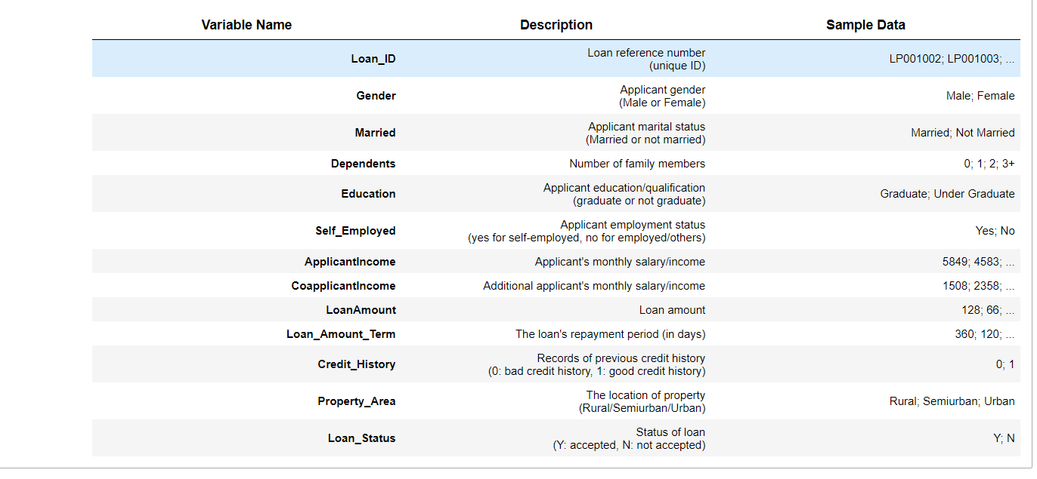
Data Set Overview
13 variables including 8 categorical, 4 continuous, 1 ID variable
614 observations

Slide 4
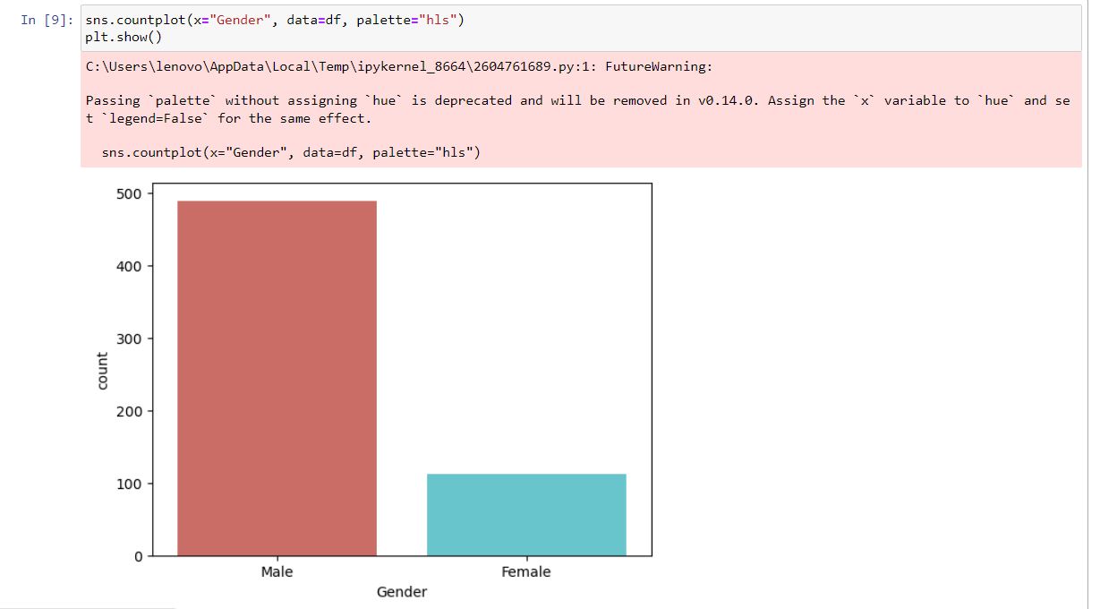
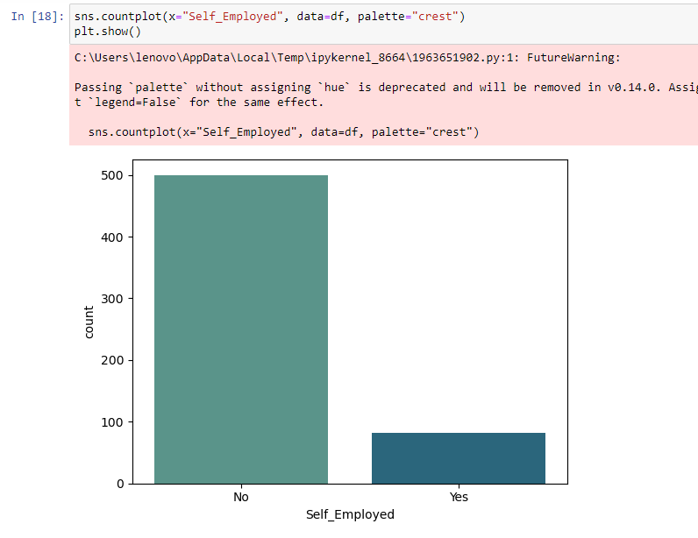
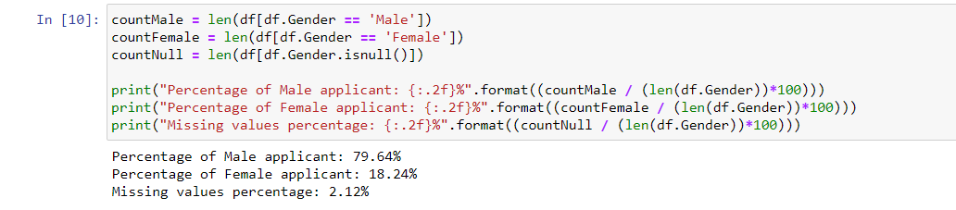

Data Exploration
Count Plots
(for Categorical Variables)

Slide 5
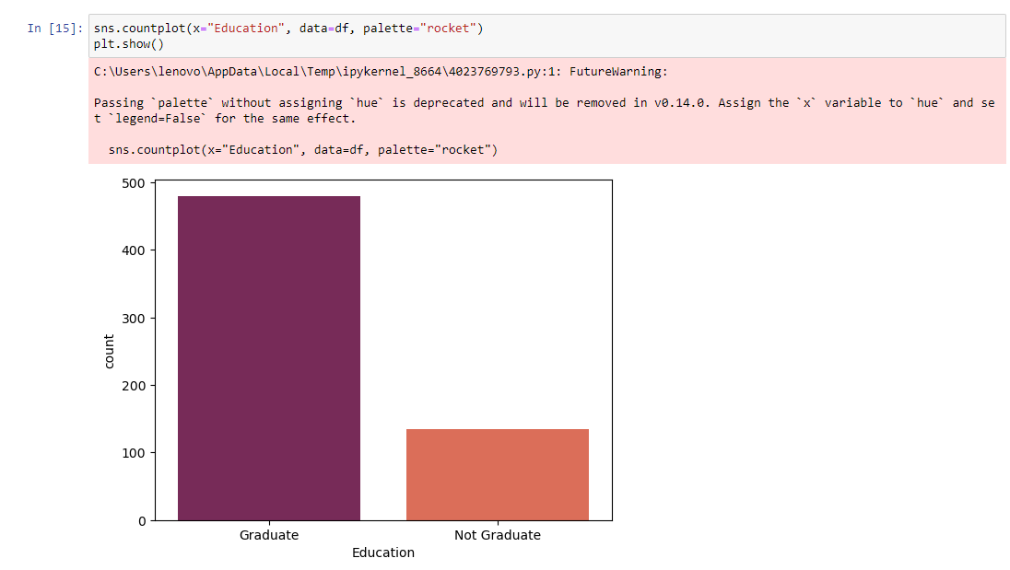
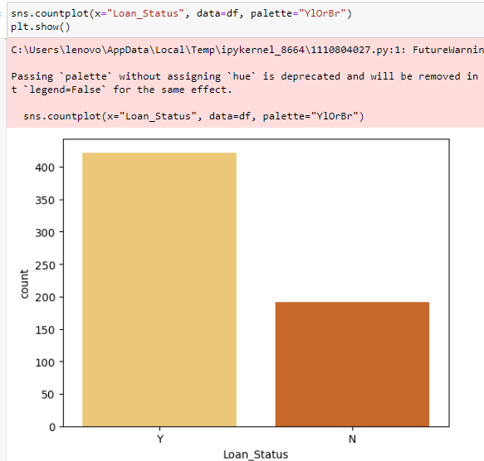



Slide 6
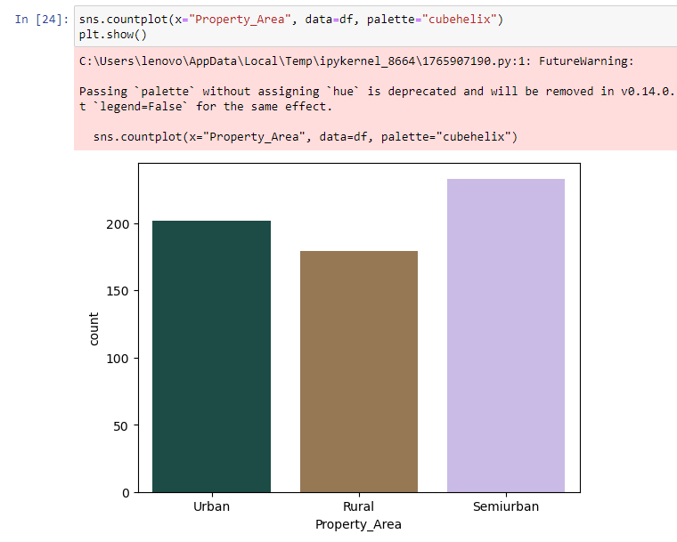
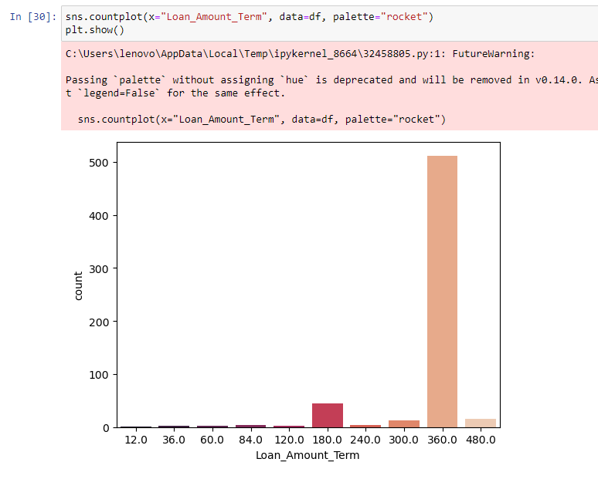


Slide 7
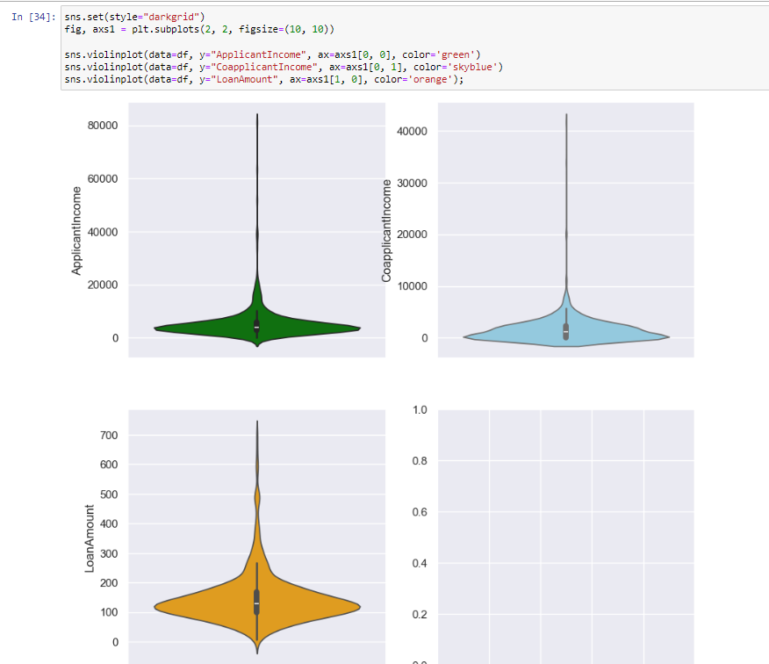
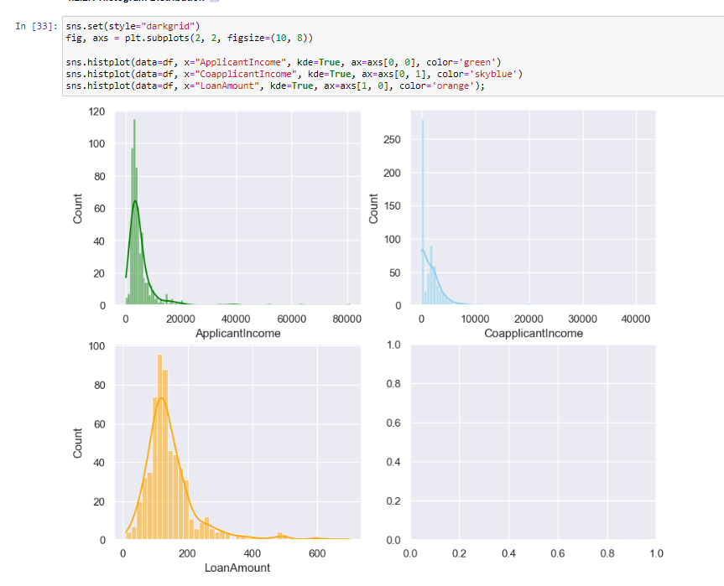
Histogram
Voilin Plot
The distribution of Applicant income, Co Applicant Income, and Loan Amount are positively skewed and it has outliers (can be seen from both histogram and violin plot).
The distribution of Loan Amount Term is negatively skewed and it has outliers.

Slide 8
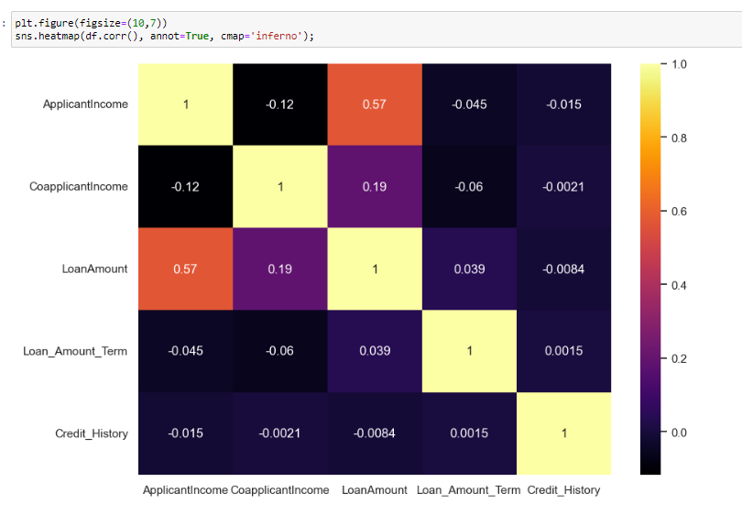
Heat map
There is positive correlation between Loan Amount and Applicant Income

Slide 9
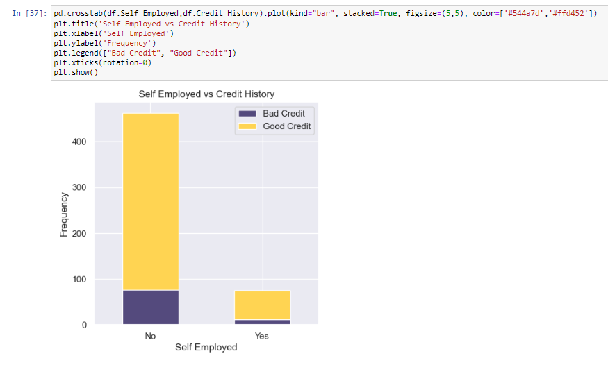
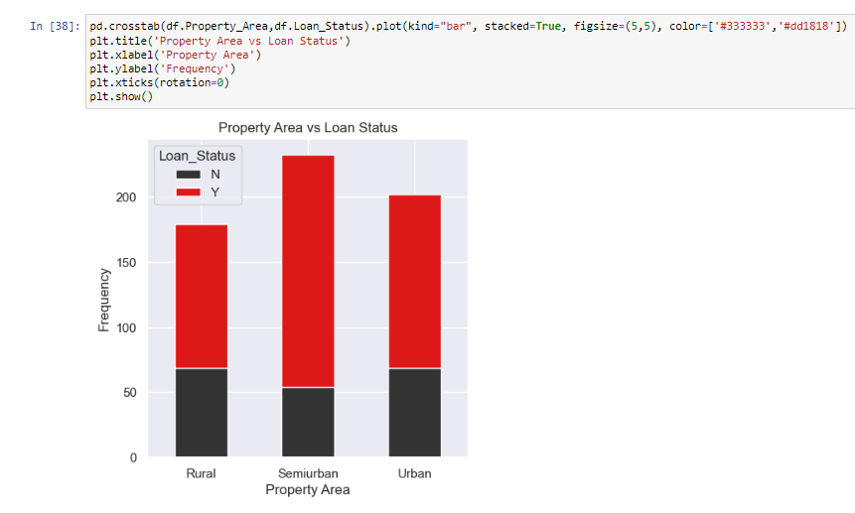
Bivariate analysis
Most not self employed applicants have good credit compared to self employed applicants.
Most of loan that got accepted has property in Semiurban compared to Urban and Rural.

Slide 10
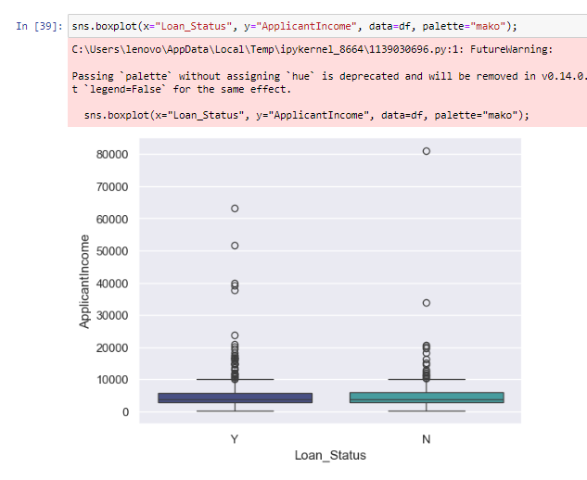
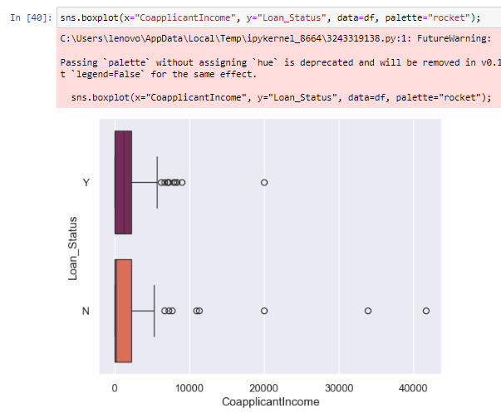
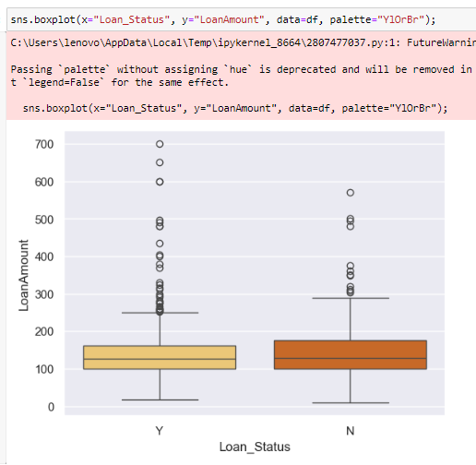
It can be seen that there are lots of outliers in Applicant Income, and the distribution also positively skewed
It's clear that Co Applicant Income has a number of outliers, and the distribution is also positively skewed.
As can be seen, Co Applicant Income has a high number of outliers, and the distribution is also positively skewed.

Slide 11
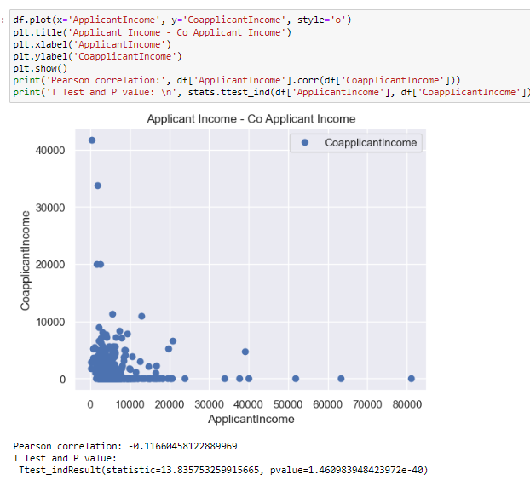
There is negative correlation between Applicant income and Co Applicant Income.
The correlation coefficient is significant at the 95% confidence interval, as it has a p-value of 1.46

Slide 12
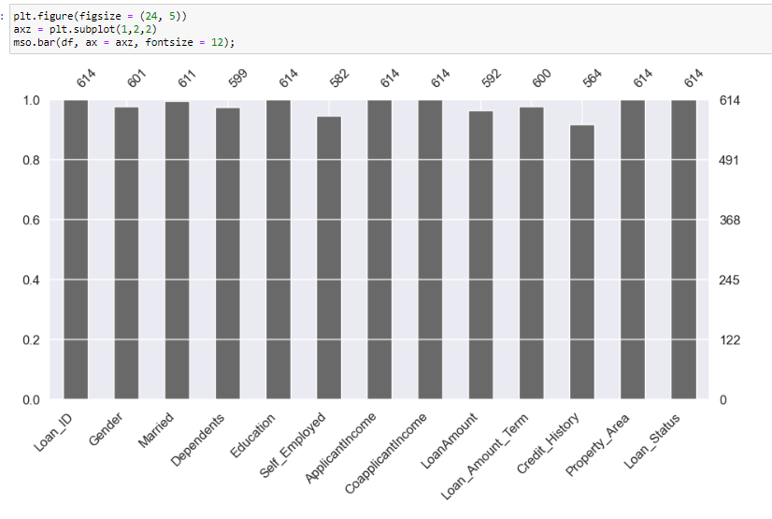
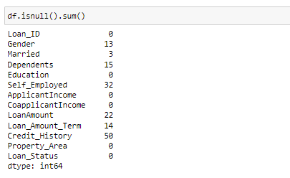
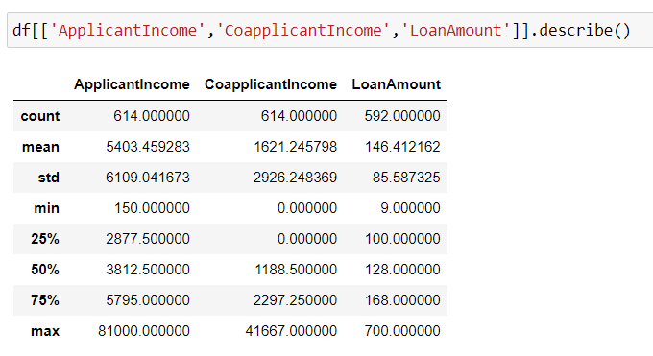
In this section, the null values has been explored for all variables in the dataset.

Slide 13

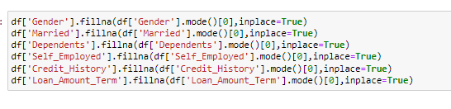

Data Preprocessing
One-hot Encoding
We transformed categorical variables into a form that could be provided by ML algorithms to do a better prediction.
Drop Unnecessary Variables
Remove Outliers & Infinite values
SMOTE Technique
The number between approved and rejected loan is imbalanced. In this section, oversampling technique is used to avoid overfitting.
Data Imputation
the imputation for categorical variables will be performed using mode.
Data Normalization
Data normalization is performed to normalize the range of independent variables or features of data.
Splitting Data Set
The data set will be split into 80% train and 20% test.
Imputation for numerical variables using mean.

Slide 14
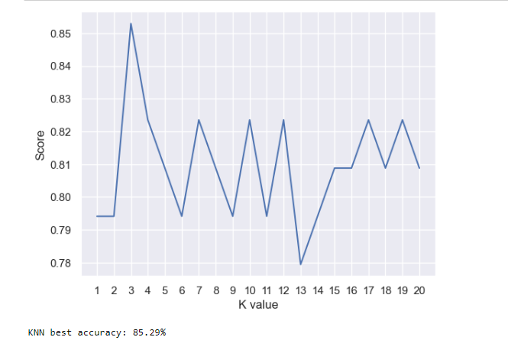
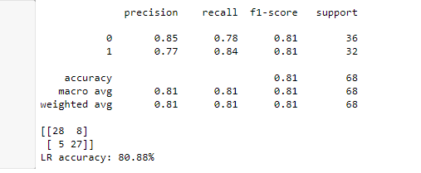
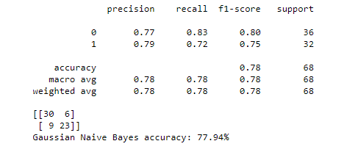
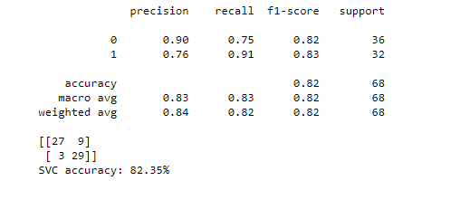
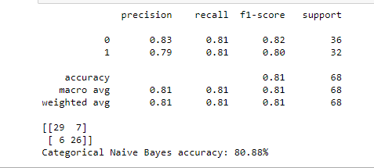
ML Models
K-Nearest Neighbour (KNN)
Logistic Regression
Gaussian NB
Support Vector Machine (SVM)
Naive Bayes
Categorical NB

Slide 15
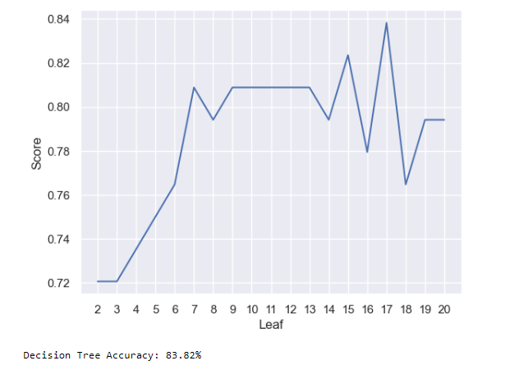
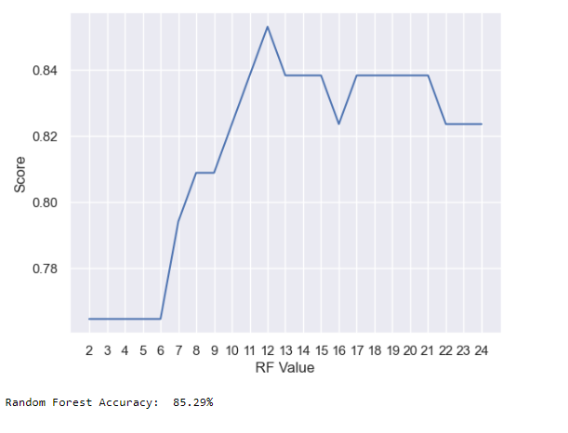
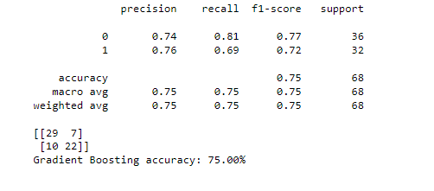
Decision Tree
Random Forest
Gradient Boosting

Slide 16
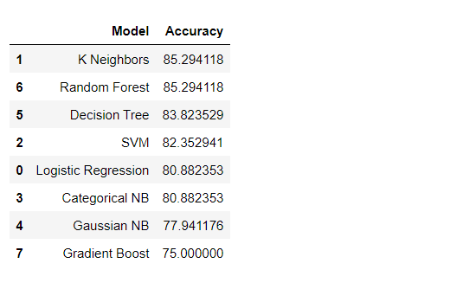
Model Comparison
In general, it can be seen that all models can achieve up to 70% accuracy.
Random Forest and KNN have highest accuracy of 85.29%.

Slide 17
Key Insights
Feature importance driving loan approval
Recommendation of best model(s)

Slide 18
THANK YOU!

